Slide 1
TWEESENT
Sentiment Analysis of COVID-19 Tweets – Visualization Dashboard
DATA ANNOTATION
By:
NameTerror
(Dhiren Soneji)

Slide 2
Data Annotation
What is Data Annotation?
Data annotation is the process of labeling the data available in various formats like text, video or images. For supervised machine learning labeled data sets are required, so that machine can easily and clearly understand the input patterns.
And to train the computer vision based machine learning model, data need to be precisely annotated using the right tools and techniques. And there are multiple types of data annotation methods use to create such data sets for such needs.

Slide 3
What are the Advantages of Data Annotation?
Improves the Accuracy of Output
As much as image annotated data is used to train the machine learning model, the accuracy will be higher. The variety of data sets used to train the machine learning algorithm it will learn different types of factors that will help model to utilize its database to give the most suitable results in various scenarios.

Slide 4
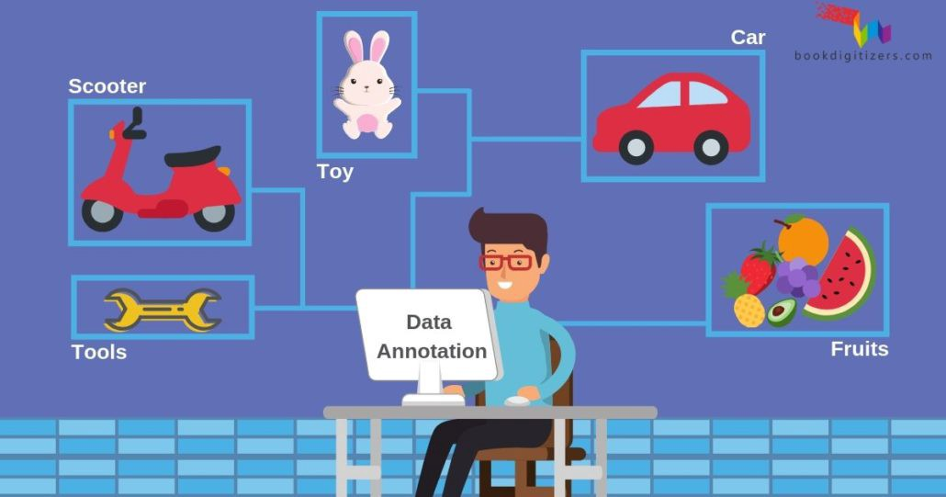
More Enhanced Experience for End-users
Machine learning based trained AI models or automated applications provide a totally different and seamless experience for end-users. Virtual assistant devices or Chatbot assist the users immediately as per their needs to solve their queries.

